Slide 1
Grocery Dealer Recommendation System
Leons Peniel

Slide 2
Introduction
There is a groceries contractor in one of the boroughs of Toronto (North York). This contractor provides places such as: Different types of Restaurants, Bakery, Breakfast Spot, Brewery and Café with fresh and high-quality groceries. The contractor wants to build a warehouse for the groceries it buys from villagers and farmers inside the borough, so that they will support more customers and also bring better "Quality of Service" to the old customers.

Slide 3
The contractor should build this warehouse where it is closest to its customers in order to minimize the cost of transportation in addition to the example above. which neighborhood (in that borough) would be a better choice for the contractor to build the warehouse in that neighborhood. Finding the right neighborhood is our mission and our recommender system will provide this contractor with a sorted list of neighborhoods in which the first element of the list will be the best suggested neighborhood.

Slide 4
Data We Need
We will need geo-locational information about that specific borough and the neighborhoods in that borough. We specifically and technically mean the latitude and longitude numbers of that borough. We assume that it is "North York" in Toronto. This is easily provided for us by the contractor, because the contractor has already made up his mind about the borough. The Postal Codes that fall into that borough would also be sufficient for us. I fact we will first find neighborhoods inside North York by their corresponding Postal Codes.

Slide 5
We will need data about different venues in different neighborhoods of that specific borough. In order to gain that information we will use "Foursquare" locational information. By locational information for each venue we mean basic and advanced information about that venue. For example there is a venue in one of the neighborhoods. As basic information, we can obtain its precise latitude and longitude and also its distance from the center of the neighborhood. But we are looking for advanced information such as the category of that venue and whether this venue is a popular one in its category or maybe the average price of the services of this venue.

Slide 6
Identifying Neighborhoods inside "North York"
We will use Postal Codes of different regions inside North York to find the list of neighborhoods. We will essentially obtain our information from https://en.wikipedia.org/wiki/List_of_postal_codes_of_Canada:_M and then process the table inside this site. Images from dataframes and also from maps will be provided in the presentation. Here we only present our strategy and how we got the mission accomplished.

Slide 7
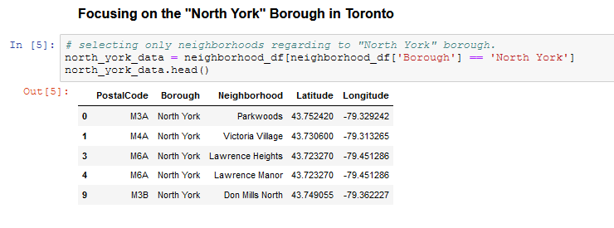
Focusing on the "North York" Borough in Toronto

Slide 8
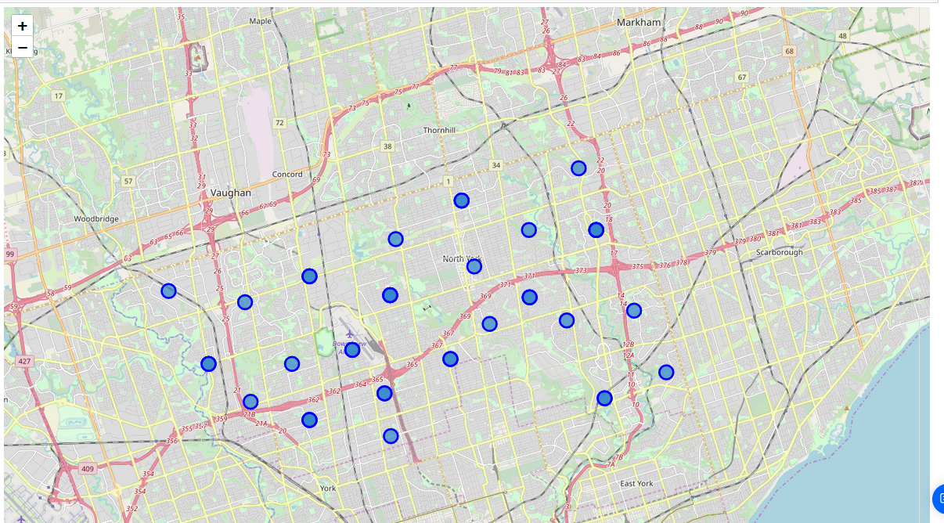
A Map of North York and Its Neighbourhoods

Slide 9
Data Wrangling

Slide 10
When the data is completely gathered, we will perform processing on that raw data to find our desirable features for each venue. Our main feature is the category of that venue. After this stage, the column "Venue's Category" will be One-hot encoded and different venues will have different feature-columns. After One-hot encoding we will integrate all restaurant columns to one column "Total Restaurants" and all food joint columns to "Total Joints" column. We assumed that different restaurants use the Same raw groceries. This assumption is made for simplicity and due to not having a very detailed dataset about different venues.

Slide 11
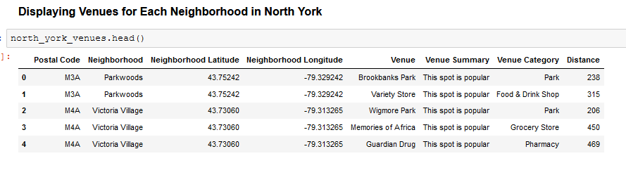
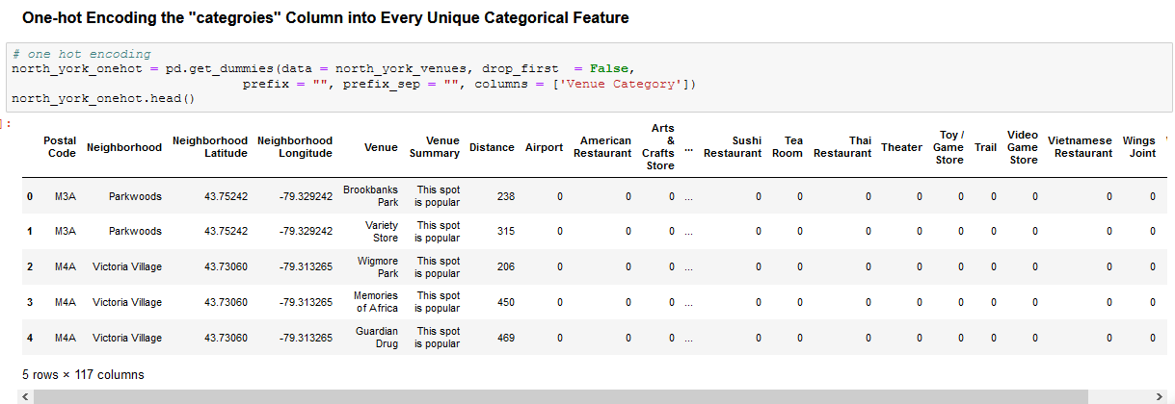

Slide 12
Machine Learning Techniques (K-Means Clustering)

Slide 13
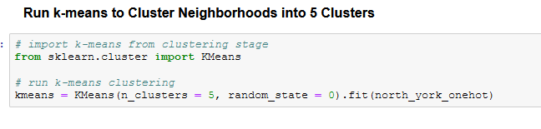
Here we cluster neighborhoods via K-means clustering method. We think that 5 clusters is enough and can cover the complexity of our problem. After clustering we will update our dataset and create a column representing the group for each neighborhood.

Slide 14
Decision Making
Now, we focus on the centers of clusters and compare them for their "Total Restaurants" and their "Total Joints". The group which its center has the highest "Total Sum" will be our best recommendation to the contractor. {Note: Total Sum = Total Restaurants + Total Joints + Other Venues.} This algorithm although is pretty straightforward yet is strongly powerful.

Slide 15
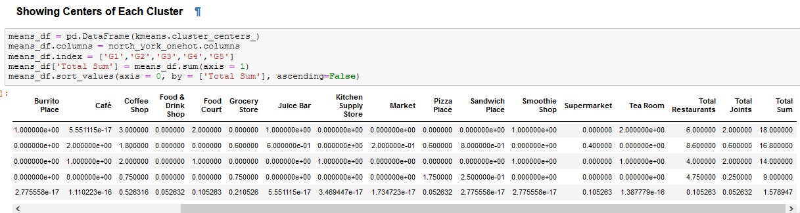

Slide 16
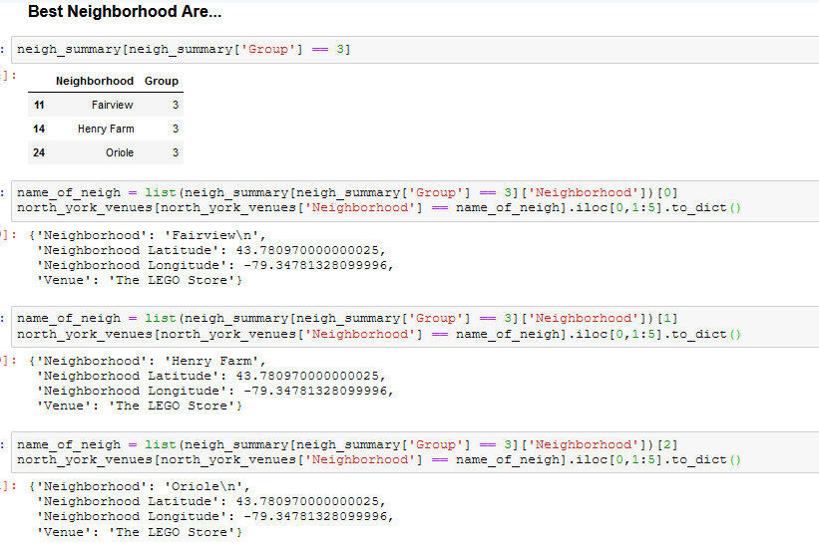
Results:

Slide 17
Thank You

